Slide 1



Cyber Risk Assessment & Threat Intelligence Platform
SP Keerthi

Slide 2
Agenda
Problem Statement
Objectives
Proposed Solution
Architecture Diagram
Implementation Details
Results
Challenges and Learnings
Future Scope
Conclusion

Slide 3

Problem Statement
Organizations face increasing cyber threats daily
Manual vulnerability detection is time-consuming
Lack of real-time risk analysis tools
Need for automated system to detect and analyze risks
No centralized dashboard for security insights

Slide 4

Objectives
Develop automated port scanning system
Identify vulnerabilities in open ports
Calculate risk scores using CVSS
Integrate threat intelligence (VirusTotal)
Provide visual dashboard with analytics
Generate downloadable reports

Slide 5

Proposed Solution
Build a Flask-based web application
Use Nmap for port scanning
Map ports to vulnerabilities
Calculate risk using scoring engine
Integrate VirusTotal API for threat data
Display results using charts & dashboard

Slide 6
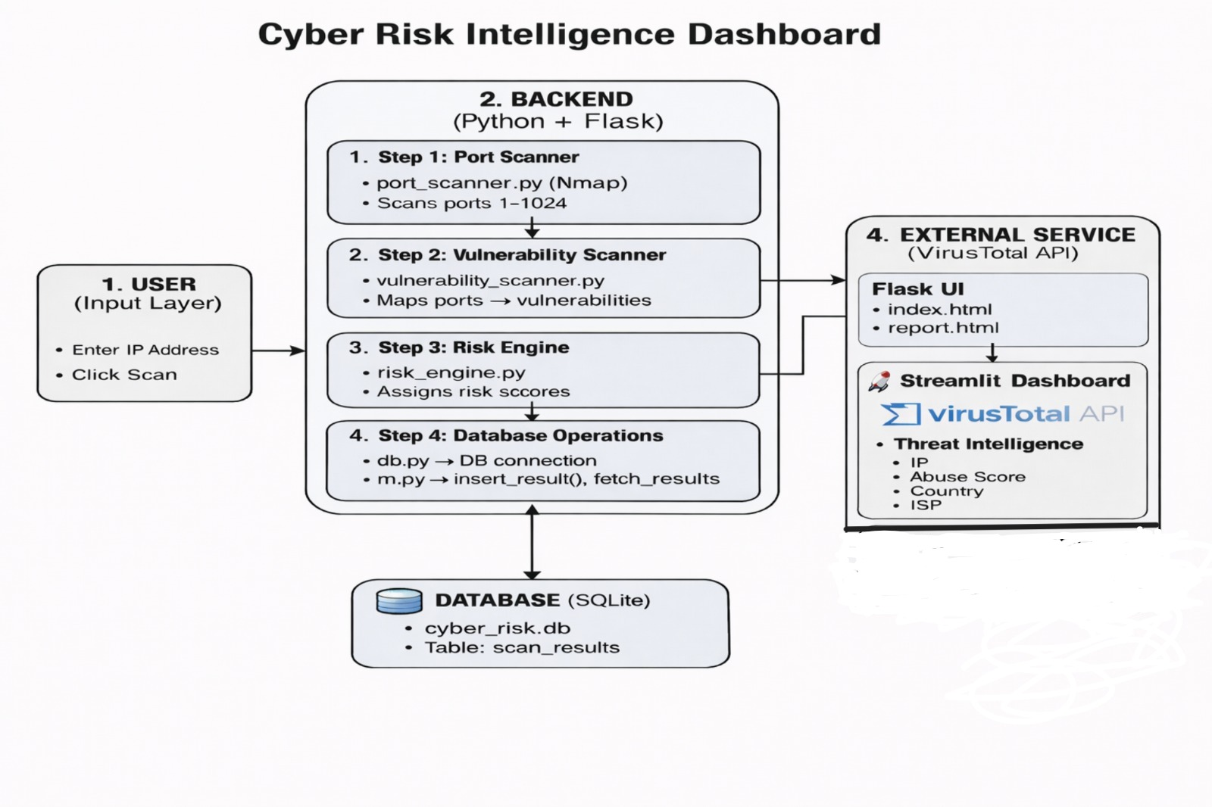
Architecture Diagram
User enters IP address
Request sent to Flask backend
Port scanner scans open ports
Vulnerability scanner detects issues
Risk engine calculates scores
Data stored in SQLite database
Dashboard displays results & charts
PDF report generated

Slide 7

Implementation Details
Backend: Python + Flask
Database: SQLite
Frontend: HTML, CSS, Chart.js, Streamlit
Threat Intelligence: VirusTotal API
Modules used:
Port Scanner
Vulnerability Scanner
Risk Engine

Slide 8
Results
Successfully detected open ports
Identified vulnerabilities with risk scores
Displayed results in visual charts
Generated accurate reports
Improved understanding of system risks

Slide 9
Challenges and Learnings
Integrating Nmap with Python
Handling API errors (VirusTotal)
Managing database efficiently
Designing dashboard UI
Flask backend development
API integration
Data visualization

Slide 10
Future Scope
Add machine learning for risk prediction
Real-time continuous monitoring
User authentication system
Cloud deployment (AWS/Heroku)
Advanced vulnerability database integration

Slide 11

Conclusion
The project successfully demonstrates a complete cyber risk assessment system combining scanning, analysis, and visualization. It simplifies security analysis and helps identify risks quickly. The platform can be extended into a full enterprise-level security tool.

Slide 12
THANK YOU

